Slide 1

ECE 5706: Resilient Computer System Design
Error Detection & Correction in
Memory Subsystems
Xin Xin
Assistant Professor
Electrical and Computer Engineering

Slide 2


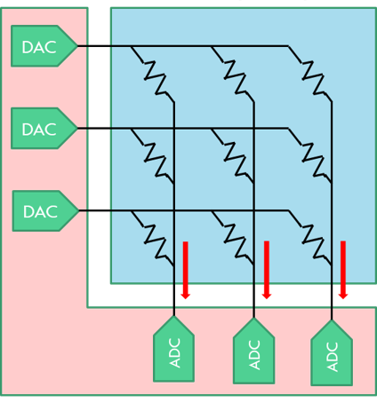
Memory Innovations
1
1
Small Array ^{[1]}
Large Cell ^{[2]}
High Cost (Cost-per-Bit)
DAC
Array
BANK
BANK
BANK
BANK
DAC
PIM
UNIT
PIM
UNIT
PIM
UNIT
PIM
UNIT
DAC
BANK
BANK
BANK
BANK
Periphery & TSV
Periphery
ADC
ADC
ADC
PIM near Banks^{[3]}
PIM using NVM ^{[4]}
[1] S. Lu, et al., MICRO (2015) [2] J. Choi, et al., ISCA (2015)
[3] S. Lee, et al., ISCA (2021) [4] S. Li, et al., ISCA (2016)
2

Slide 3
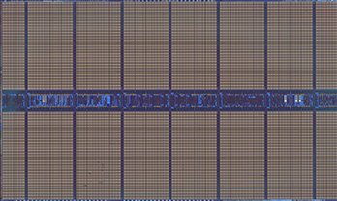

Challenge - Cost
Deeply Optimized
Logic
(20~30% )
Performance-oriented
Capacity-oriented
Storage Cells
CPU
High Design Cost
Incompatible Technologies
2X/4Yr
Scaling Challenges
2X/3Yr
4X/3Yr
  Longer time between generations
Chip
Density
Data: IBM’2010
3

Slide 4



Mitigating the Cost
$1000
$100
1600M
$10
400
800
Cost-per-bit
Perf/BW
NVM
DDR
HBM
eDRAM
A Different Perspective
LPDDR
GDDR
HBM
HBM
DRAM
chip
rank0
logic
HBM
+
HBM
HBM
rank1
Hybrid Memory
Near Data Processing
4

Slide 5
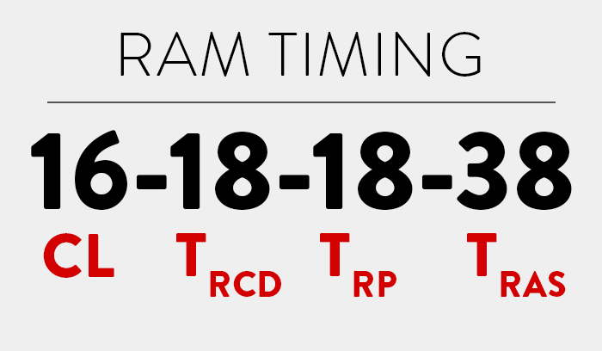
Low Design Cost
Redundant in-mem Resources
  Spare row/column
  Conservative timing
  Redundancy in future memory
Weak
Healthy
Timing
Spare Rows
Potential Opportunities
  Recycle under-utilized resources
  Repurpose existing resources
Performance vs Cost
  Cost-per-bit: Capacity
  Performance: Bandwidth/Latency
Perf.
Cost
5

Slide 6
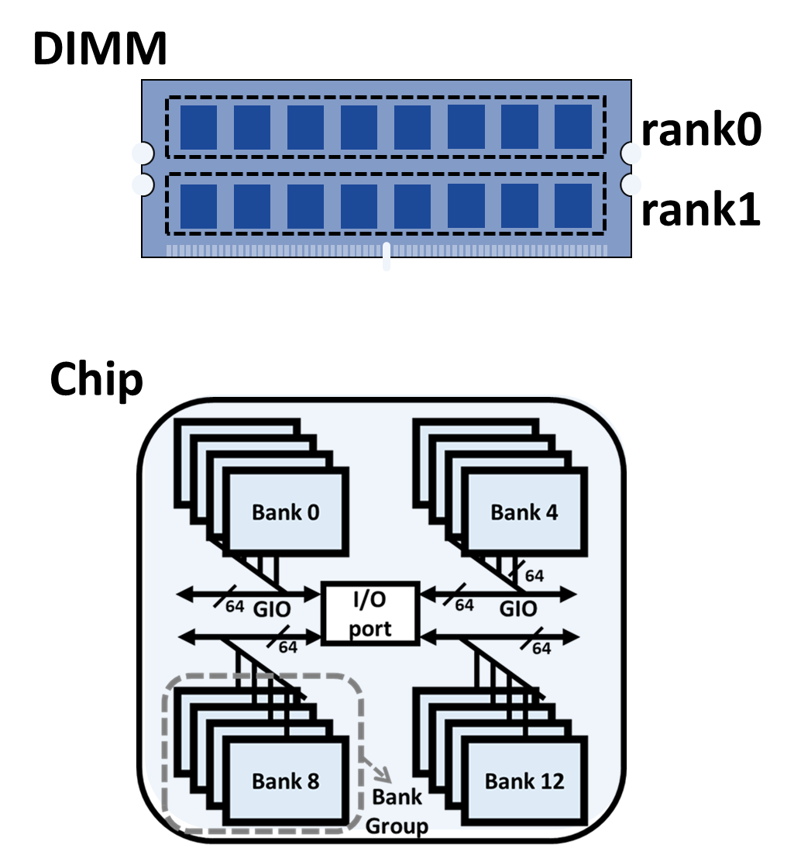
Background – Architecture
DIMM
Rank
Chip
Bank/BG
Subarray
Mat
Cell
6

Slide 7
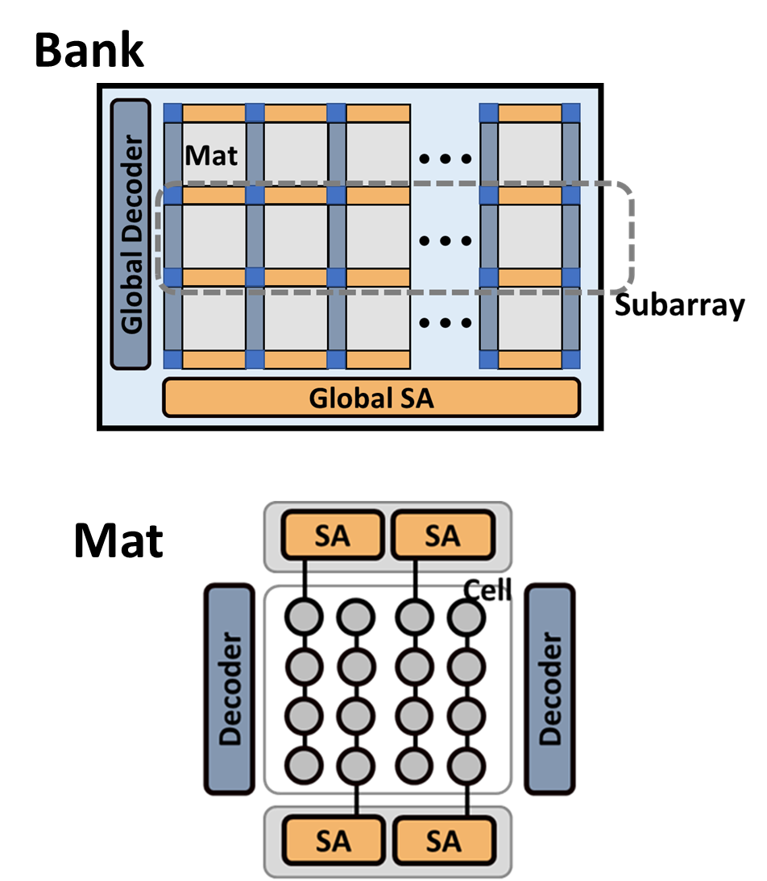
Background – Architecture
DIMM
Rank
Chip
Bank/BG
Subarray
Mat
Cell
7

Slide 8
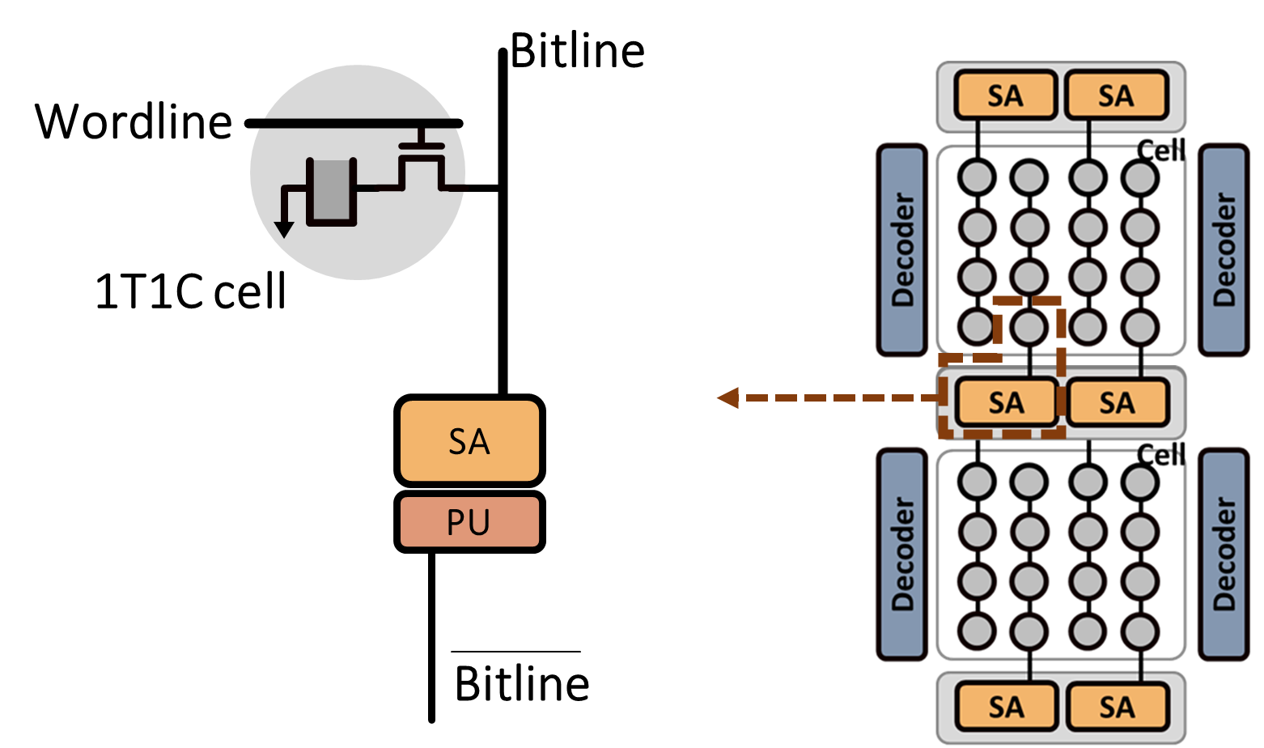
Background – Architecture
8

Slide 9
ECC conclusion
Bit-level protection:
Hamming code, e.g., SEC-DED
Symbol-level protection:
Checksum-based, e.g., RS code
Arithmetic Operation protection:
AN-code and residue code
RRNS-based code
9

Slide 10
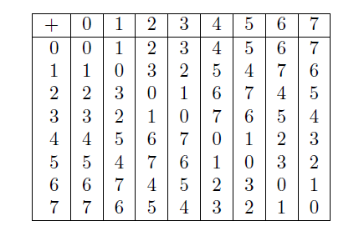
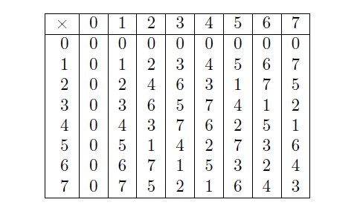
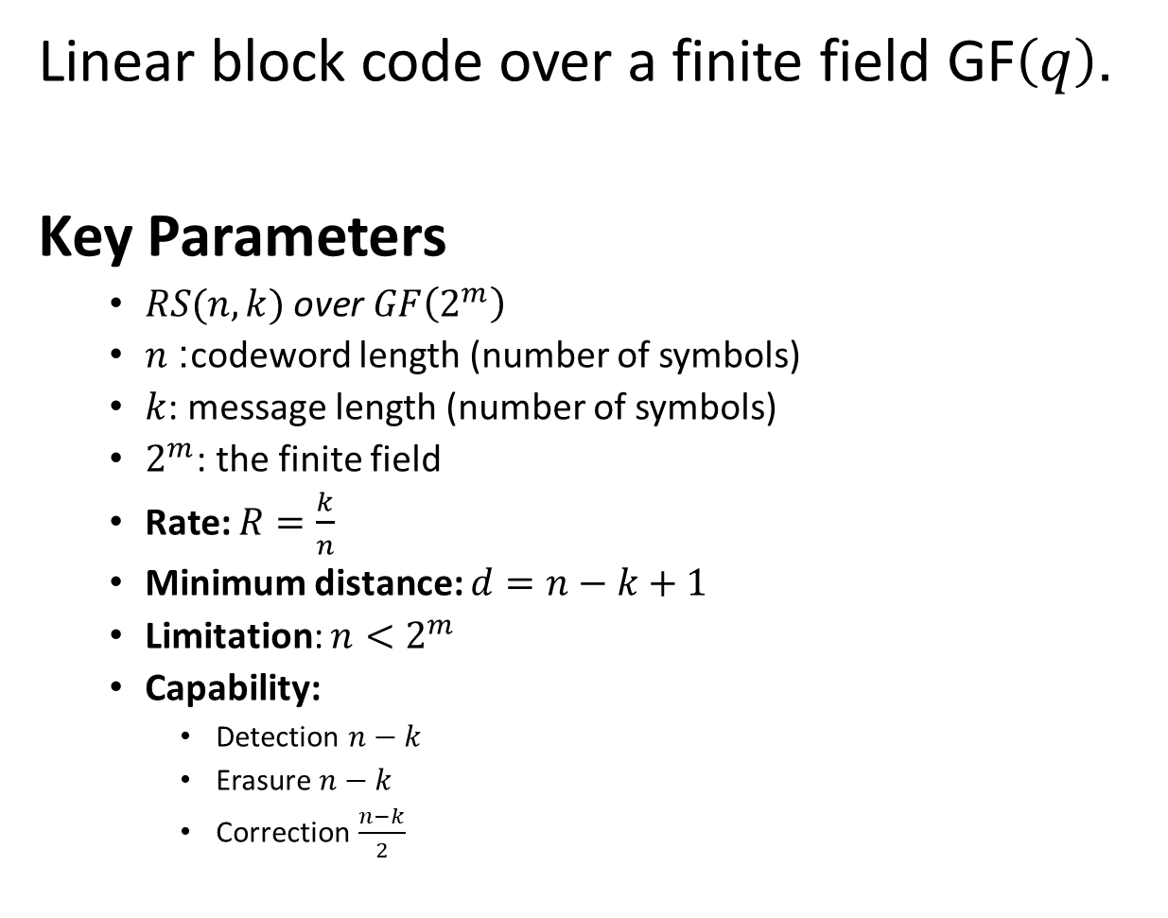
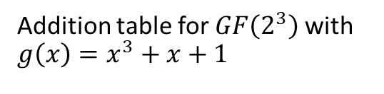
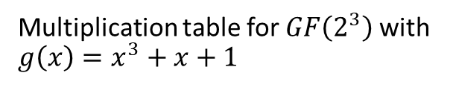
Reed Solomon Code
Linear block code over a finite field $\text{GF}\left(q\right)$.
Key Parameters
  $RS(n, k) \text{over }GF\left(2^{m}\right)$
  $n$: codeword length (number of symbols)
  $k$: message length (number of symbols)
  $2^{m}$: the finite field
  Rate: $R=\frac{k}{n}$
  Minimum distance: $d=n−k+1$
  Limitation: ${n<2}^{m}$
  Capability:
    Detection $n−k$
    Erasure $n−k$
    Correction $\frac{n−k}{2}$
Addition table for $GF\left(2^{3}\right)$with $g\left(x\right)=x^{3}+x+1$
Multiplication table for $GF\left(2^{3}\right)$with $g\left(x\right)=x^{3}+x+1$
10

Slide 11
ECC Studies
Bamboo ECC: Strong, Safe, and Flexible Codes for Reliable Computer Memory
Jungrae Kim Michael Sullivan Mattan Erez
2015
11

Slide 12
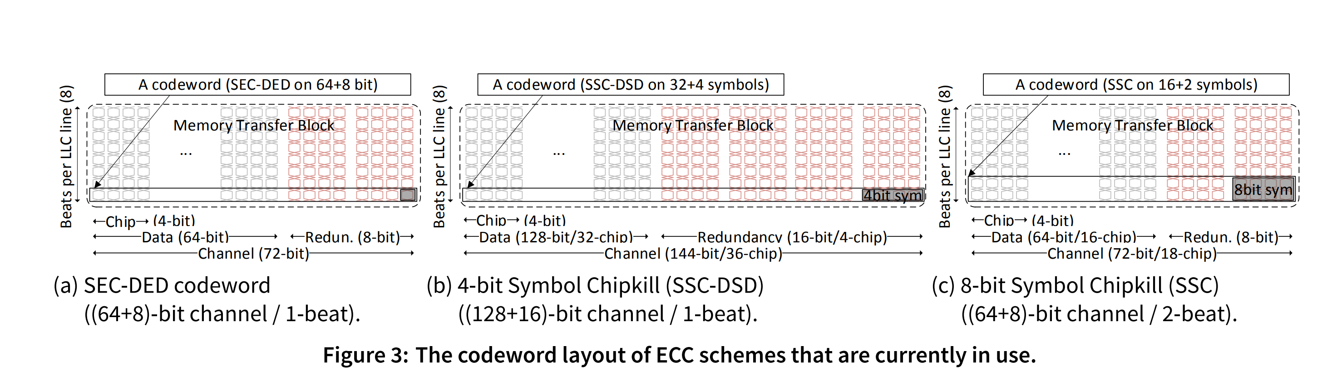
Bamboo ECC
12

Slide 13
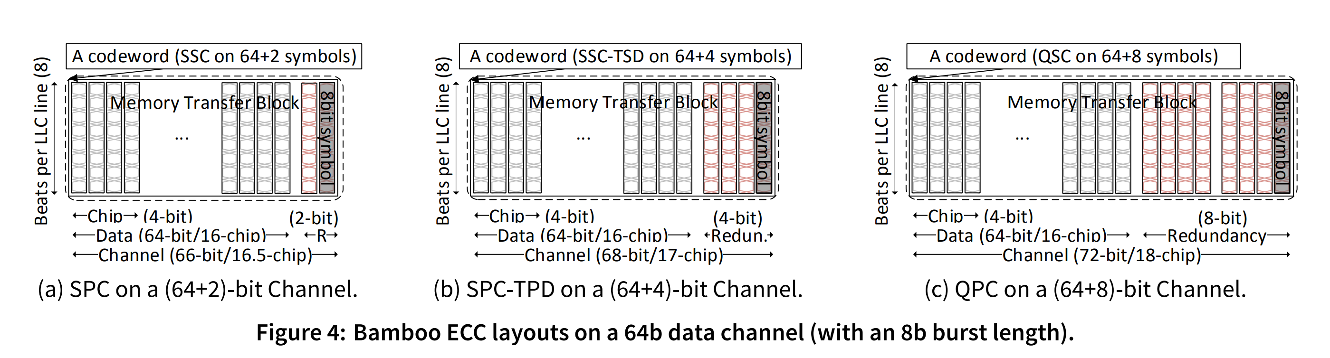
Bamboo ECC
Larger Codeword!
The QPC encoder consumes about 25,000 NAND2 gates of area, a ×16 increase over that of AMD chipkill.
13

Slide 14
ECC Studies
LOT-ECC: LOcalized and Tiered Reliability Mechanisms for Commodity Memory Systems
Aniruddha N. Udipi† Naveen Muralimanohar‡ Rajeev Balsubramonian† Al Davis† Norman P. Jouppi
2012
14

Slide 15
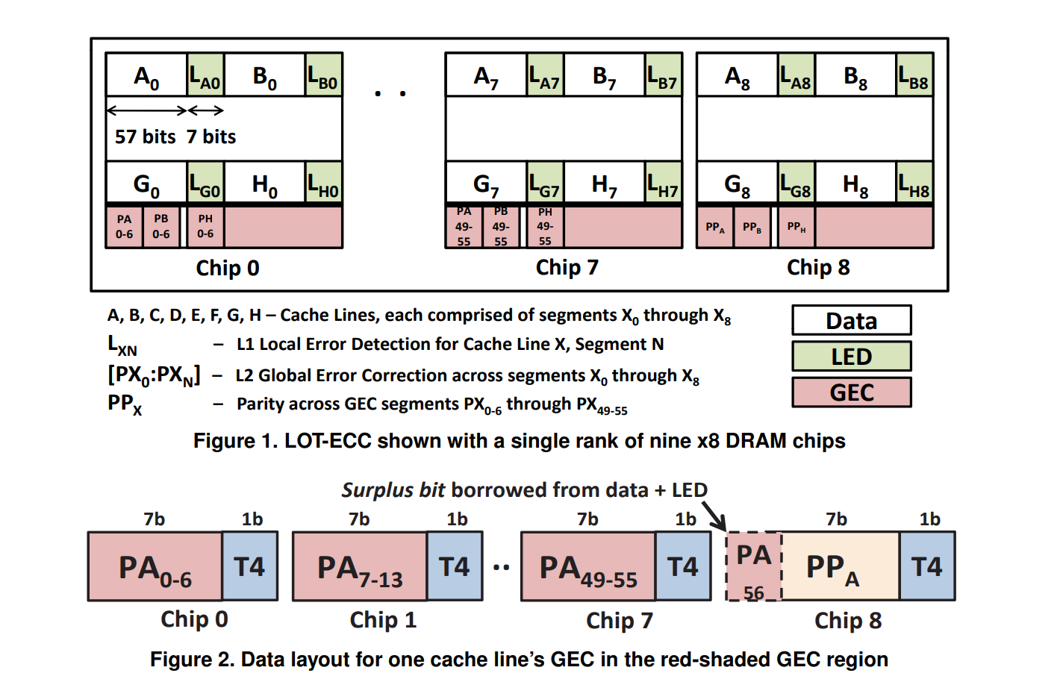
LOT-ECC
Hierarchical Organization
Extra Write
15

Slide 16
ECC Studies
Virtualized and Flexible ECC for Main Memory
Doe Hyun Yoon, Mattan Erez
2010
16

Slide 17
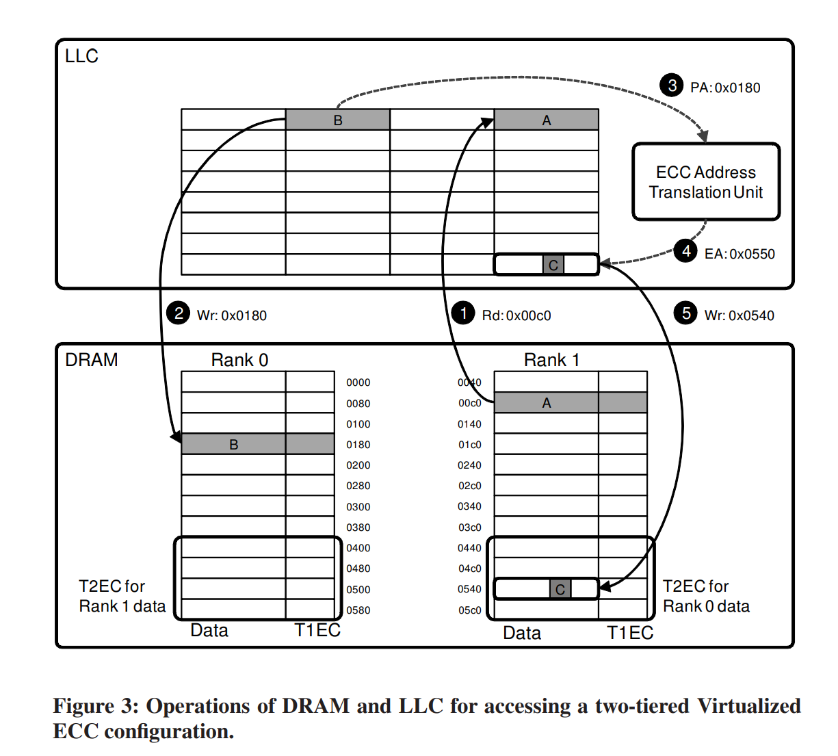
VECC
Separated Detection and Correction
17

Slide 18
ECC Studies
DUO: Exposing On-chip Redundancy to Rank-Level ECC for High Reliability
Seong-Lyong Gong† Jungrae Kim‡ Sangkug Lym† Michael Sullivan∗ Howard David? Mattan Erez†
2018
18

Slide 19
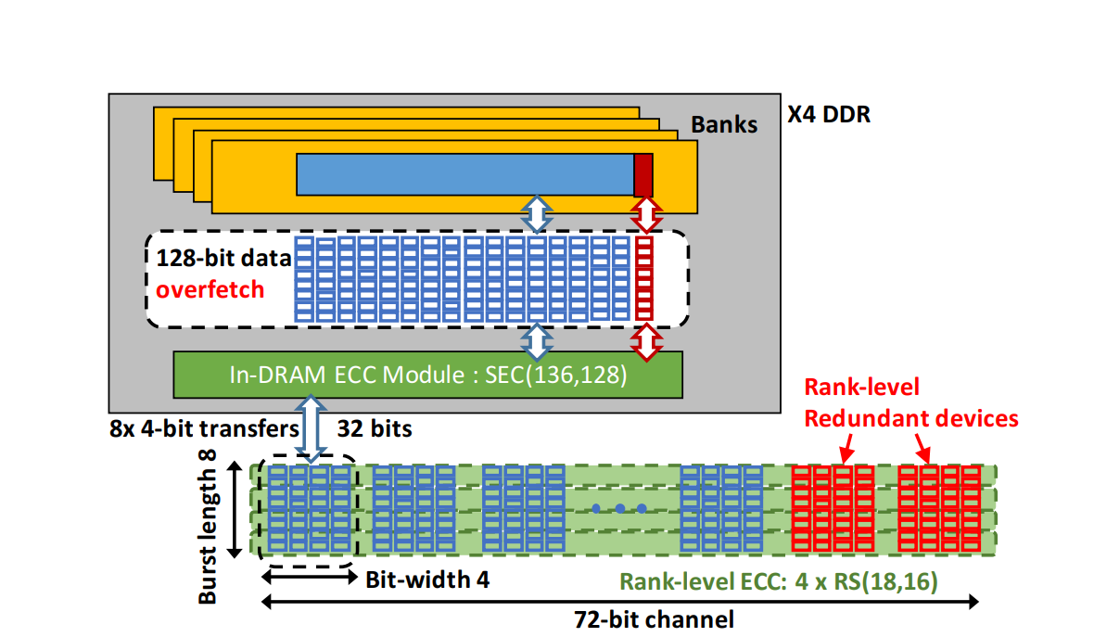
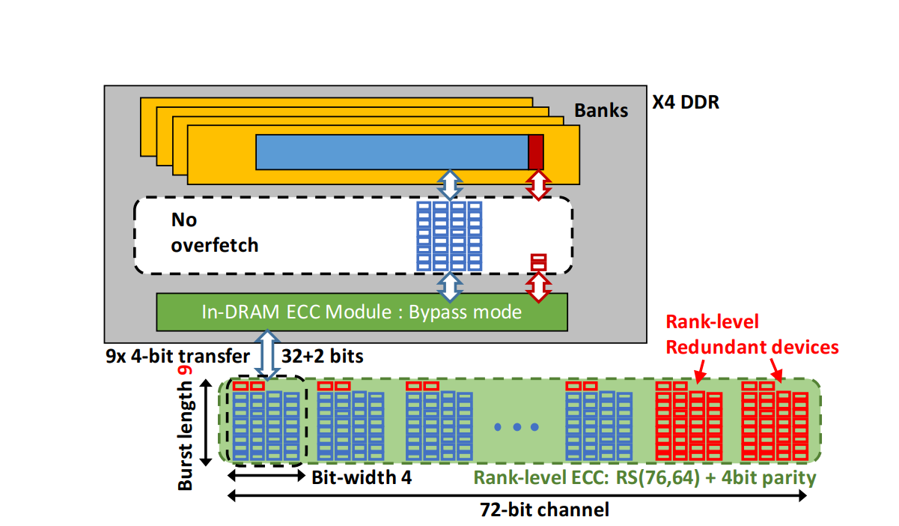
Duo ECC
Redundancy
19

Slide 20
ECC Studies
Revisiting Residue Codes for Modern Memories
Evgeny Manzhosov, Adam Hastings, Meghna Pancholi, Ryan Piersma, Mohamed Tarek Ibn Ziad, and Simha Sethumadhavan
2022
20

Slide 21
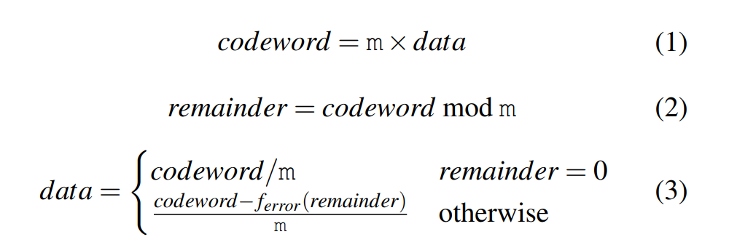
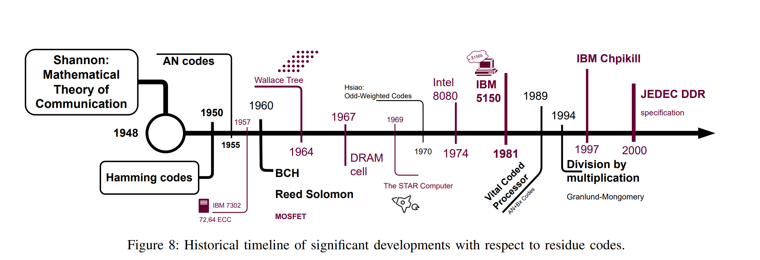
Duo ECC
Redandency
21

Slide 22
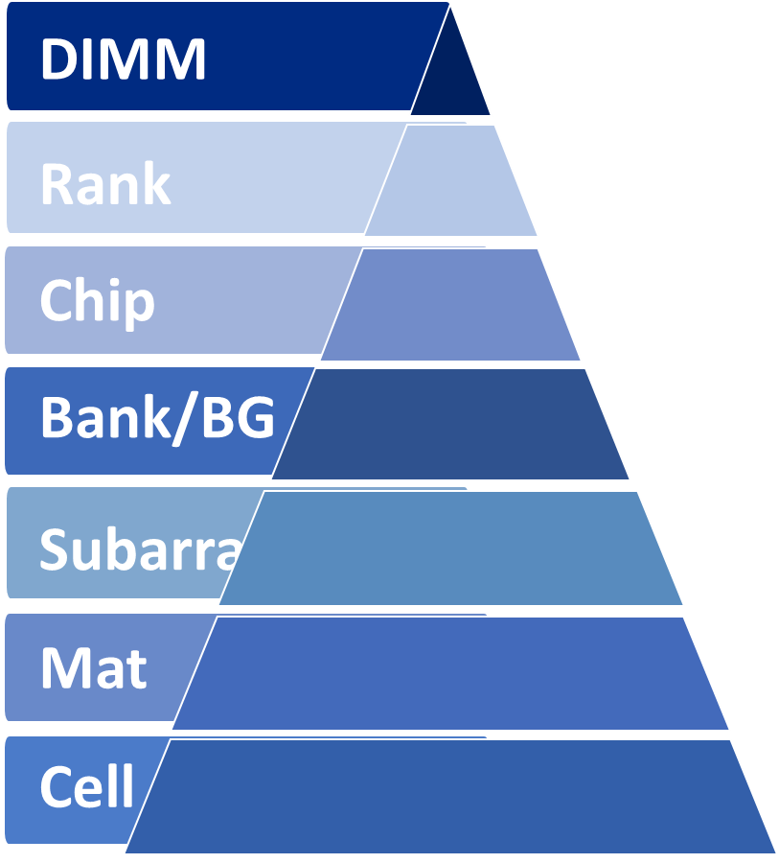
Further Studies
Data Chips
ECC Chips
ECC Resources
Detect
Correct
Traditional ECC Process
  Detection + Correction
Decoupled ECC Process
  1st detection only
  2nd errors detected, correction
Example: Chip-Kill ECC
22

Slide 23
Overview
Overhead
(Cost)
Improving Memory Performance at Low Cost
Exploring more bandwidth
Efficient PIM, HPCA’20
Reduced Operation PIM, DAC’19
Bandwidth
Improving bandwidth efficiency
Strided Access Mem, MICRO’21
Hiding MetaData, Ongoing
$
Latency
Reducing access latency
Reduced Restore, DAC’20
Hybrid Mem, DAC’22
23

Slide 24
Ongoing Work
Overhead
(Cost)
Hybrid Memory
  DRAM + NVM
  HBM + DRAM
Persistency
Bandwidth
Power
Memory-centric Innovations
  Processing in Memory (PIM)
  Near Data Processing (NDP)
  Memory-based Accelerators
Latency
Security
Reliability
24

Slide 25

Ongoing Work - Mem Reliability
Data Chips
ECC Chips
Storage Reliability
  Incompatible ECC schemes
Computation Reliability
  Homomorphic ECC schemes
Protection Capability
  DRAM: fine-grained codeword
  NVM: stronger ECC
array
control
DRAM
logic
array
control
NVM
25

Slide 26


Ongoing Work - Mem in Space
Aerospace System - Radiation
  Conventional Radiation-Hardened Memory (High reliability)
  Commercial Memory (Low cost)
1. Data Organization
  Distributed in wider space
2. More Storage Errors
  Efficiently Characterize Weak Cells
  Augmented Detect + Regular Correct
3. More Logic Errors
  Peripheral Circuits are Important
  Address Protection
Widely Distributed
Weak Cell
Address Protection
Characterization
32
32
More ECC
32
32
Stronger Detection
26

Slide 27
Ongoing Work
Reconfigurable Accesses
Access Pattern:
  Sequential, e.g., bulk-size
  Strided, e.g., column-wise access
  Random, e.g., pointer chasing
  Access granularity:
  Regular data size, e.g., cache line
  Customized data size, e.g., meta data
  Varied data size, e.g., compression
27

Slide 28
THANK YOU!
Xin Xin
xin.xin@ucf.edu

